Slide 1
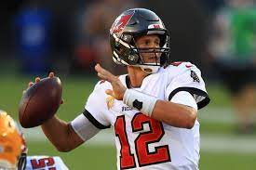

QB Touchdown Prediction Model
By Garrett Hass
Data Science Project August 1, 2022

Slide 2

The Issue:
We need to know how many touchdowns a QB will throw in game.
The average TDs thrown per game:
1.11
What stats have a correlation??
Can we predict how many a player will throw?

Slide 3
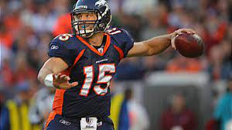
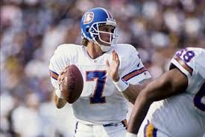
The Solution to the Problem:
Create a model to predict how many TDs the Quarterback will throw.

Slide 4
Player | Team | Gms | Att | Cmp | Pct | Yds | YPA | TD | TD% | Int | Int% | Lg | Sack | Loss | Rate
Aaron Rodgers | GB | 16 | 552 | 371 | 67.2 | 4,295 | 7.8 | 39 | 7.1 | 8 | 1.4 | 73 | 51 | 293 | 108.0
Peyton Manning | DEN | 16 | 583 | 400 | 68.6 | 4,659 | 8.0 | 37 | 6.3 | 11 | 1.9 | 71t | 21 | 137 | 105.8
Robert Griffin III | WAS | 15 | 393 | 258 | 65.7 | 3,200 | 8.1 | 20 | 5.1 | 5 | 1.3 | 88t | 30 | 217 | 102.4
Russell Wilson | SEA | 16 | 393 | 252 | 64.1 | 3,118 | 7.9 | 26 | 6.6 | 10 | 2.5 | 67 | 33 | 203 | 100.0
Matt Ryan | ATL | 16 | 615 | 422 | 68.6 | 4,719 | 7.7 | 32 | 5.2 | 14 | 2.3 | 80t | 28 | 210 | 99.1
Tom Brady | NE | 16 | 637 | 401 | 63.0 | 4,827 | 7.6 | 34 | 5.3 | 8 | 1.3 | 83t | 27 | 182 | 98.7
Ben Roethlisberger | PIT | 13 | 449 | 284 | 63.2 | 3,265 | 7.3 | 26 | 5.8 | 8 | 1.8 | 82t | 30 | 182 | 97.0
Drew Brees | NO | 16 | 670 | 422 | 63.0 | 5,177 | 7.7 | 43 | 6.4 | 19 | 2.8 | 80t | 26 | 190 | 96.3
Our Dataset is a compilation of QB information from 1996-2016
https://www.kaggle.com/datasets/speckledpingu/nfl-qb-stats

Slide 5
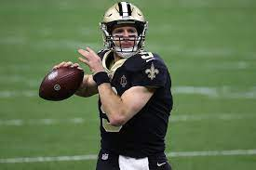
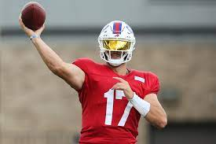
Data Wrangling
Started with 14 columns and 13,188 rows
Dropped certain rows
Add a few columns
NaN values
I ended up with 19 columns and 13,172 rows.
Target Variable is touchdowns

Slide 6
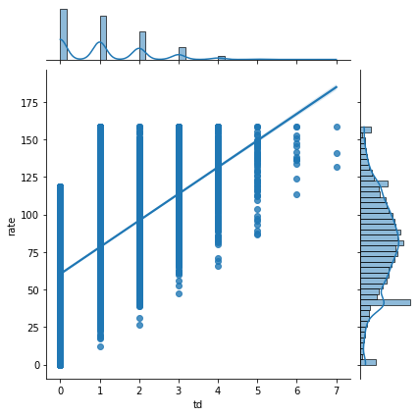
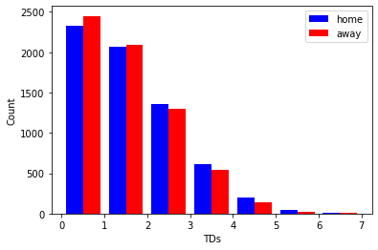
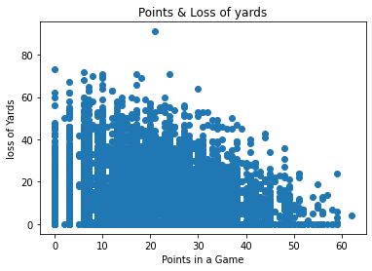
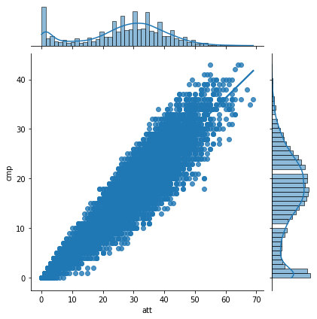
EDA

Slide 7

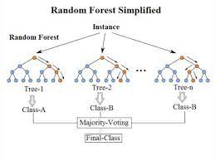
Regression Model Selection
Linear Regression
Lasso Regression
Ridge Regression
The best one was:
Random Forest Regression

Slide 8
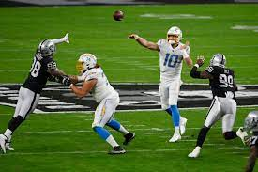
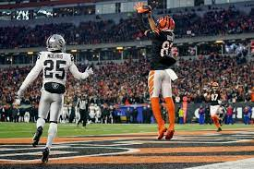
Hyperparameter Tuning
Grid Search Cross Validation
Improved the Random Forest Model by .0007 points
From .9971 to .9978

Slide 9
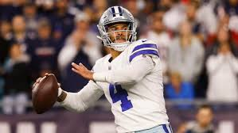
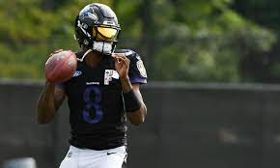
Main Ideas
Random Forest Model was the best with an R2 Score of .9978
Predicting TDs could help win more games
Most important stat besides final score
This will help to identify who start, bench or sign

Slide 10
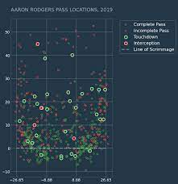
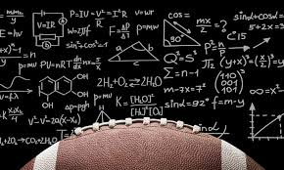
Future Recommendations
Use models for other variables for every major stat
Metrics on all 22 positions
Offense, Defense, and Special Teams
Situational Analytics

